Slide 1
Annual Advocacy Awareness Webinar Part 1 - Introduction to the Legislative Process July 22, 2020
Presented by: Vernon M. Langford MSN, APRN, FNP-C
Jean Aertker, DNP, APRN, FNP-BC, COHN-S, FAANP
Ed Briggs, DNP, APRN, FNP-C
Notes:
VERNON 1-15
JEAN 16-31
ED 32-43

Slide 2
Objectives
1. Review the process of bill making and the legislative process in Florida.
2. Review the recent legislative bills of importance to APRNs
3. Provide a unified plan for advocacy efforts to protect and enhance the APRN role.
Notes:
Need for CE

Slide 3
Disclosures
All speakers have No conflict of Interest or Disclosures to report
Notes:
Need for CE

Slide 4
Florida Coalition of Advanced Practice Nurses
Mission: To build a cohesive foundation of all APN stakeholders. The coalition is committed to promoting creative solutions using advanced practice nursing models to address the health care needs of all Floridians. A Collective and Unified Voice for Florida APRNs.
Organized the first Florida APRN Coalition meeting in Tallahassee, Florida on March 14, 2007. Grew out of the former ARNP Task Force
A Network of all Florida APRN group leaders invited by invitation
Discuss, Plan and Act on Practice, Professional and Legislative issues.
Notes:
Your elected leaders have a seat of the coalition. Two Co-leaders appointed each for 2 yrs and rotate off. When items come up for decision making each group gets one vote. Actions to move on agenda items in the name of the coalition must be unanimous. Past co-chairs may remain on coalition but not in voting capacity unless representing their group again.

Slide 5
MEMBERS OF The Florida Coalition of Advanced Practice Nurses
American Psychiatric Nurses Association: Florida Chapter
Association of Advanced Practice Nurses in Business: Florida Chapter
Central Florida Advanced Practice Nursing Council
Florida Affiliate of the American College of Nurse Midwives
Florida Association of Neonatal Nurse Practitioners
Florida Association of Clinical Nurse Specialists
Florida Association of Nurse Anesthetists
Florida Association of Nurse Practitioners
Florida Nurse Practitioner Network
Florida Nurses Association
Florida Gerontologic Advanced Practice Nurses Association
South Florida Council of Advanced Practice Nurses
Tampa Bay Advanced Practice Nurses Council
Florida Chapter of NAPNAP
Notes:
14 groups now members. Brings together all interested advanced practice nursing organizations with the goal of improving healthcare delivery and access in Florida.

Slide 6
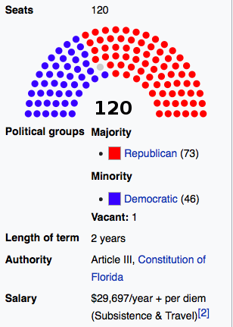
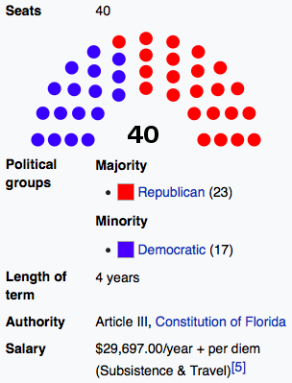
Getting to Know Your Florida Legislature
Notes:
Seat images from https://en.wikipedia.org/wiki/Florida_Senate and House 6/26/2020
CAPTAL IMAGE https://www.floridacapitol.myflorida.com/the_capitol/capitol_history
FL CHANNEL IMAGE https://thefloridachannel.org/?s=captial+building+

Slide 7
Brief Legislative Process Review How a Bill becomes a Law
New laws start with ideas, problems to be fixed or updates to old laws
House or Senate Legislator agrees to sponsor, draft and file a bill
Companion Bills maybe introduced-Bill is assigned one or more committees
The proposed bill is debated, amended, adopted or dies in committee
Review Process continues - if passes goes to the floor of House & Senate
A Final Joint session votes on Bill – must pass in both House & Senate
Notes:
1 A legislator or an interested party has an idea that is brought to the attention of the proper person, generally a legislator. That idea is then drafted into a bill or proposed legislation. A bill can originate in either chamber (House of Representatives or Senate), however the process differs slightly between chambers.
2 Either a member of the House or Senate can file a bill. How can I tell the difference between a House and a Senate bill?
House and Senate bills are numbered in serial order as they are filed. House bills receive odd numbers (1, 3, 5, …) and are prefixed by "H" or "HB"; Senate bills receive even numbers (2, 4, 6, ...) and are prefixed by "S" or "SB."
The bill is assigned to a committee or several committees, depending on the content of the measure. These proposals usually have a companion bill in the other chamber. Companion bills are similar and address the same issues.
3 The proposed legislation is amended and debated at the committee level. If approved in committee, they are forwarded to the next committee of reference and then to the floor of the House of Representatives and Senate for further action. Further debate and amendments can occur on the floor of either the Senate or the House. Companion bills often move through the process concurrently.

Slide 8
Brief Legislative Process Review How does an idea become a law in Florida? (Continued)
If a bill passes in one house of the legislature, it is sent to the other house for review.
A bill goes through the same process in the second house as it did in the first.
A bill can go back and forth between chambers until a consensus by lawmakers is reached.
Of course, the measure could fail at any point in the process.

Slide 9
Brief Legislative Process Review How does an idea become a law in Florida? (Continued)
Once a bill has passed on the floor in both chambers in identical form, it proceeds to the Governor for a signature. Once signed by the Governor, the bill becomes law. If the Governor vetoes the bill, then it takes a 2/3 majority of both the Senate and the House to override his veto. A bill may also become a law if the Governor does not sign or veto it within a specific amount of time after the bill has been presented to the Governor.
The public, lobbyists, or a group's representatives can provide input on the legislation at each of the above stages.

Slide 10
How An Idea Becomes Law – Florida SENATE
Notes:
Appropriations, Implementing, and Conforming bills
Relief or Claims Bill
Committee Bill or Committee Substitute
Companion Bill, Joint Resolution,
Engrossed Bill and Enrolled Bill
General Bill
Others: Linked Bill, Local Bill, Memorial, Proposed Committee Bill. Resolution, Reviser's Bill and Trust Fund Bill
The House Bill Drafting Service is a nonpartisan, nonpolitical office that provides professional legislative drafting services for all members, committees, and subcommittees of the House.
The Glossary is found under a table on the Bills filed of the House and Senate Pages. It has 18 pages of terms you may need to look at to understand the process of bill drafting to final bill.
Relief Bill define:
General Bill:
Committee Substitute
Companion Bill
The office Randy Havlical Director and Bill Welge Deputy Staff Director are responsible for preparing drafts for most general bills, joint resolutions, concurrent resolutions, memorials, and House resolutions; reviewing drafts of local bills; preparing committee and subcommittee substitutes; preparing floor amendments and, upon request, committee or subcommittee amendments; and filing all bills, committee or subcommittee substitutes, and floor amendments with the Clerk. In addition, the office prepares drafts of tributes for individual members to commemorate local achievement, condolences, or other recognition.

Slide 11
Legislative Regular Session & Annual Calendar
The 2021 Legislative Session Calendar has not been released yet.
Notes:
The Florida Legislature meets in session every year for sixty consecutive days. A regular session of the legislature shall convene on the first Tuesday after the first Monday in March of each odd-numbered year, and on the second Tuesday after the first Monday in January of each even-numbered year. There are other ways in which the Legislature may be convened as outlined in Article III, Section 3, of the Florida Constitution, including special sessions, which may be called either by the Governor; or by a joint proclamation issued by the Senate President and House Speaker. An extension of regular session or special session requires a three-fifths vote of each house. DESPITE THIS>>>The Legislature STILL WORKIGN ON UNEMPLOYMENT ISSUES WITH COVID!!

Slide 12
Committees of Interest to the APRN’s
FL SENATE | FL HOUSE
Health Policy | Health Quality Subcommittee
Appropriations Subcommittee on Health and Human Services | Health Care Appropriations Subcommittee
Appropriations | Health and Human Services Committee
Notes:
WHERE DO THE BILLS GET REFERRED TO VOTE ON?

Slide 13
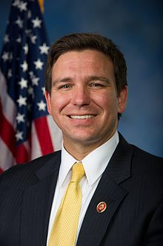
2020 FLORIDA GOVERNOR
Senator Ron DeSantis (R)
Florida Governor
REPUBLICAN
Tallahassee Office
Office of Governor Ron DeSantis State of Florida The Capitol 400 S. Monroe St. Tallahassee, FL 32399-0001
(850) 717-9337
TERM OF OFFICE: 2019- 2023
Notes:
Image retrieved on 7-11-19 https://www.flgov.com/:

Slide 14
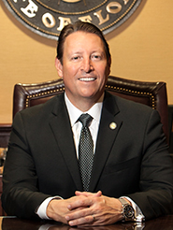
2019-2020 Legislative Leadership SENATE PRESIDENT (Outgoing)
Senator Bill Galvano (R)
Senate President
District Office
1023 Manatee Avenue West Suite 201 Bradenton, FL 34205 (941) 741-3401 Senate VOIP: 42100
Tallahassee Office
305 Senate Building 404 South Monroe Street Tallahassee, FL 32399-1100 (850) 487-5021 Senate VOIP: 5021
Notes:
Image retrieved on 7-11-19 from https://www.google.com/search?biw=1787&bih=856&tbm=isch&sa=1&ei=gWEpXc6fCfWO9PwPh_Kg2AE&q=what+happened&oq=what+happened&gs_l=img.3..0l10.236529.238272..239126...0.0..0.67.697.13......0....1..gws-wiz-img.......0i67.0GMleCILZs0#imgrc=fnGhlE-3l5gGyM:

Slide 15
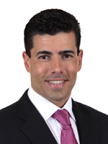
2019-2020 Legislative Leadership HOUSE SPEAKER (Outgoing)
Representative Jose Oliva (R)
Speaker of the House
District Office
3798 West 12th Avenue
Suite A
Hialeah, FL 33012-4126
(305) 364-3114
Tallahassee Office
420 The Capitol
402 South Monroe Street
Tallahassee, FL 32399-1300
(850) 717-5110
Speaker Oliva made HB 607 (APRN Autonomous Practice) his central focus and was a legislative champion for all of Session. We thank him sincerely for his efforts and for his support
Notes:
Expanding the scope of practice was the top priority for House Speaker Jose Oliva, who has devoted much of his tenure instituting responsible health care reform and making it more affordable for Floridians. Coming into his final legislative session, Oliva sought to allow nurses to practice freely without any regulation.
Image retrieved on 7-11-19 from https://www.google.com/search?biw=1787&bih=856&tbm=isch&sa=1&ei=gWEpXc6fCfWO9PwPh_Kg2AE&q=what+happened&oq=what+happened&gs_l=img.3..0l10.236529.238272..239126...0.0..0.67.697.13......0....1..gws-wiz-img.......0i67.0GMleCILZs0#imgrc=fnGhlE-3l5gGyM:

Slide 16
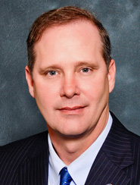
2020-2021 Legislative Leadership SENATE PRESIDENT (Incoming)
Senator Wilton Simpson (R)
Incoming Senate President
District Office
4076 Commercial Way
Spring Hill, FL 34606
(352) 688-5077
Senate VOIP: 41000
Tallahassee Office
420 Senate Building
404 South Monroe Street
Tallahassee, FL 32399-1100
(850) 487-5010
Senate VOIP: 5010
Notes:
Senate President: the next Senate President, Sen. Wilton Simpson of Trilby, is also from Tampa Bay, means the region will have a concentrated amount of power for the next three years when it comes to both policy and the state’s purse-strings after elections in November.
Image retrieved on 7-11-19 from https://www.google.com/search?biw=1787&bih=856&tbm=isch&sa=1&ei=gWEpXc6fCfWO9PwPh_Kg2AE&q=what+happened&oq=what+happened&gs_l=img.3..0l10.236529.238272..239126...0.0..0.67.697.13......0....1..gws-wiz-img.......0i67.0GMleCILZs0#imgrc=fnGhlE-3l5gGyM:

Slide 17
2020-2021 Legislative Leadership HOUSE SPEAKER (Incoming)
Representative Chris Sprowls (R)
Incoming Senate President
District Office
Suite 100
2364 Boy Scout Road
Clearwater, FL 33763-0901
(727) 793-2810
Tallahassee Office
422 The Capitol
402 South Monroe Street
Tallahassee, FL 32399-1300
(850) 717-5065
Notes:
Rep. Chris Sprowls, R- Palm Harbor will be Speaker of the House this new term. makes him only the second House speaker from Pinellas in state history after Rep. Peter Rudy Wallace in 1995. Sprowls, 35, may have been politically active since his youth. But during that same period, Sprowls also waged a much more personal fight against Hodgkin’s lymphoma, a cancer of the lymphatic system, which is part of the immune system. He was diagnosed with the disease at 18, and it delayed his start in college.
Image retrieved on 7-11-19 from https://www.google.com/search?biw=1787&bih=856&tbm=isch&sa=1&ei=gWEpXc6fCfWO9PwPh_Kg2AE&q=what+happened&oq=what+happened&gs_l=img.3..0l10.236529.238272..239126...0.0..0.67.697.13......0....1..gws-wiz-img.......0i67.0GMleCILZs0#imgrc=fnGhlE-3l5gGyM:

Slide 18
Year | Bill or Legislative Effort | Action – Impact
2012 |  | 11/26/12 Appointed to Committee Memberships
2013 | CS/CS/HB 239-Optometry CS/HB 413 Physical Therapy CS/HB 625 PA’s | ALL “Non” bills passed. OD bill was H&HS Committee Bill Pigman as PT co-sponsor to order meds
2104 | HB7071 APRN ((Workforce Innovation and Pigman) CS/CS/HB7113 Health Care | Both Died in H&HS Committee/Messages Name was “IAPRN”
2015 | CS/CS/HB 281 Drug Prescription ARNP and PA HB 27A (Special Session 2015A) CS/CS/HB 335 Psych Nurses | Died on Second Reading on calendar- Died in Health Policy Passed-Baker Act IN&OUT
2016 | HB 423 Access to Health Care Services Lumpkin Rx Act HB 1063 RN Compact | Both Passed
2017 | CS/CS/HB 543 Regulation of Health Care Practitioners CS/HB7011 Health Care Access | PASSED REMOVED Joint Committee for our practice/protocol!! DIED on second reading calendar.
2018 | HB 573 Invol.B.Act Exams CS?CS/HB21 Controlled Subs | Died on Health Policy C-Sub Passed.
2019 | HB 821 Health Care Practitioners | Died in Health Policy May 3, 2019
2020 | CS/CS/HB 607/SB 1676 | PASSED
Tracing the dedicated effort of Representative Cary Pigman 2012-2020
.
Notes:
Rep Pigman elected Nov 2012, his1st session was 2013 under Speaker Corcoran was Impressive—Je started in 2012…first year freshman got on health committees. Yellow were successful NP bills and Red bills failed…

Slide 19
Tracing the Path of House Bill 607 in 2020
Filed by Original Bill Filed : “Independent practice” for APRNs who meet the following requirements and who registered with the Board of Nursing:
The APRN must have an active, unencumbered license to practice as an APRN in Florida and not have been subject to disciplinary action in Florida or any other state within the past 5 years
The APRN must have completed at least 3,000 clinical practice hours or clinical instruction hours while practicing as an APRN under the supervision of a MD or DO with an unencumbered license, or the APRN must have completed a graduate-level course in pharmacology and differential diagnosis.
Representative Cary Pigman
Notes:
Follow what happened with this bill from start to finish SINE DIE. And use glossary terms
Filed by Representative Cary Pigman.
Original Bill Filed : “independent practice” for APRNs who meet the following requirements and who registered with the Board of Nursing:
The APRN must have an active, unencumbered license to practice as an APRN in Florida and not have been subject to disciplinary action in Florida or any other state within the past 5 years
The APRN must have completed at least 3,000 clinical practice hours or clinical instruction hours while practicing as an APRN under the supervision of a MD or DO with an unencumbered license, or the APRN must have completed a graduate-level course in pharmacology and differential diagnosis

Slide 20
House Bill 607 (2020) Continued
The Board of Nursing would register APRNs who meet the stated qualifications for independent practice and that APRN would have received an independent practice license (by role).
Independent APRNs would have had to renew their licenses every 2 years and take 10 hours of continuing education in addition to the 30 hours required for licensee renewal.
Requires independent APRNs to report adverse incidents involving controlled substances.
Notes:
Also - Requiring a licensed home health agency that authorizes a registered nurse to delegate tasks to a certified nursing assistant or a home health aide to ensure that certain requirements are met; requiring home health aides to complete annual in-service

Slide 21
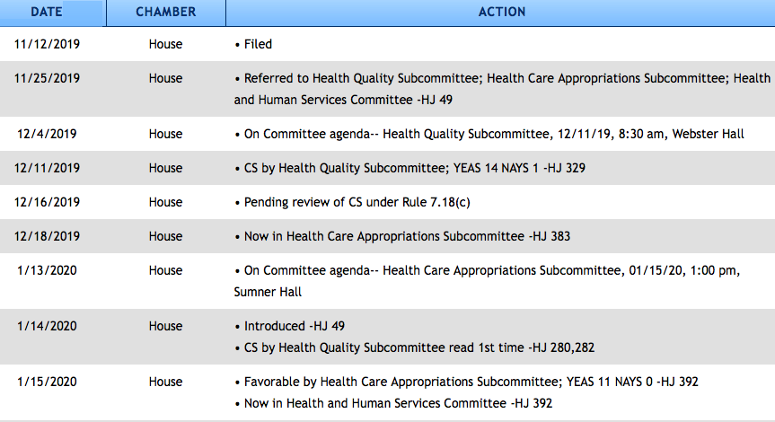
The Road to Passage of House Bill 607 (Continued - 1 of 3)
Notes:
Highlight the Process of the bill
Referred to 3 committees in the House
Votes were all favorable and quick started on 12/11/19 early!!
One NAY VOTE Was the dem Whip Richard Stark Democrat

Slide 22
The Road to Passage of House Bill 607 (Continued - 2 of 3)

Slide 23
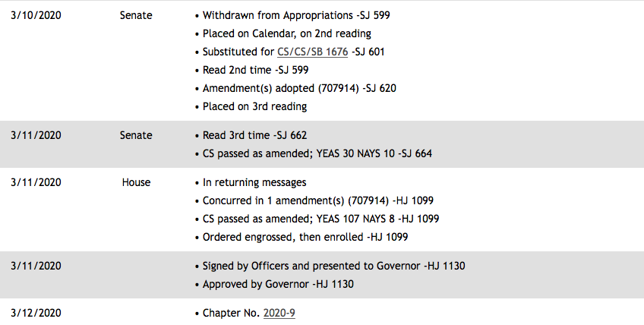
The Road to Passage of House Bill 607 (Continued - 3 of 3)

Slide 24
HB 607: What It Does Do
Provides a PATHWAY to Independent Practice for Nurse Practitioners (and CNMs) who practice in primary practice, including family medicine, general pediatrics, and general internal medicine, ONLY as defined by board rule and who meet certain qualifications.
(NO OTHER SPECIALTIES – Not Psych, Not Cardiology, Not Women’s Health, etc.)
This is a specific license that must be applied for after meeting all required qualifying metrics. This is not awarded automatically to anyone. If you choose not to seek this license, NOTHING in your current practice as an APRN changes
Once the APRN license of independent practice is successfully issued, the NP is granted signature authority which includes the Baker Act involuntary examination, signing death certificates, admitting/discharging patients from a facility and “provide a signature, certification, stamp, verification, affidavit, or endorsement that is otherwise required by law to be provided by a physician (except for medical cannabis).

Slide 25
HB 607: What it Does NOT Do
Does not impact “specialty” practices
Does not impact CNS or CRNA practice
Does not impact precepting someone who may seek independence.
Does not give independence automatically to ANY APRN
Does not change protocol requirements for ANY APRN who does not apply for IP
Does not change your ability to own and operate your own practice
Does not impact your malpractice insurance UNLESS you decide to apply for IP

Slide 26
HB 607 : Qualifying for Autonomous Practice
3,000 hours of clinical practice hours, which may include clinical instructional hours, within the 5 years immediately preceding the application request
CNMs must have a written patient transfer agreement with a hospital and a written referral agreement with a physician to engage in nurse midwifery.
3 graduate-level semester hours, or the equivalent, in BOTH differential diagnosis AND Pharmacology within the 5 years immediately preceding the application request, or equivalent (45 Continuing Education credits)
Must obtain and maintain professional liability coverage (malpractice insurance) in the amount of at least 100k per claim / 300k aggregate or obtain and maintain an irrevocable letter of credit in the amount of at least 100k per claim / 300k aggregate
Notes:
The IP license of the APRN must be renewed every 2 years with their standard APRN license but an additional 10 hours of continuing education approved by the BON must now be completed in addition to completing 30 hours of continuing education requirements required already by the BON.
An APRN who practices independently in a primary care health professional shortage area (eligible for up to $15,000 per year from the DOH in student loan repayment.

Slide 27
APRN-IP Council Members Appointed July 1, 2020
.
Board of Nursing
Charitta Ernewein, DNP, APRN, FNP (2 year term) Vicky Stone-Gale, DNP, APRN, FNP (4 year term) Sandra Williamson, APRN, CNM (3 year term) Kathleen Wilson, PhD, APRN, FNP (2 year term)
Board of Medicine
Shailesh Gupta, MD (3 year term) Hector Vila, MD (4 year term)
Board of Osteopathic Medicine
Michelle Mendez, DO (4 year term) Joel Rose, DO (2 year term)
Cassandra G. Pasley, BSN, JD, Director of the Division of Medical Quality Assurance, will serve as Chair of the Council as the State Surgeon General’s designee
Notes:
HB 607 : HB 607 : Qualifying for Autonomous Practice The Board of Nursing shall adopt rules, in consultation with a new established Council on Advanced Practice Registered Nurse Autonomous Practice for independent practice
The council shall recommend standards of practice for APRNs registered as independent and is composed of 9 members:
This council shall recommend standards of practice for APRNs registered as independent and is composed of 9 members:
2 members appointed by the chair of the Board of Medicine who are physicians and members of the Board of Medicine,
2 members appointed by the chair of the Board of Osteopathic Medicine who are physicians and members of the Board of Osteopathic Medicine,
4 members appointed by the Board of Nursing (BON) who are APRNs
The State Surgeon General, or his or her designee who shall serve as the chair of the Council

Slide 28
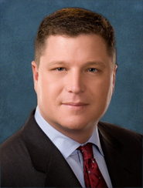
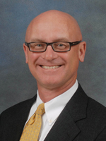
Special Thanks for Your Continued Support
Senator Jeff Brandes
Republican: District 24
Rep. Cary Pigman, MD
Republican: District 55
Notes:
Senator Jeff Brandes past champion the APRN Autonomous Practice bill may help again.
NCSBN support in 2021 with Floridians Unite for Health Care

Slide 29
Coalition Activities During the 2020 Legislative Session
Personal letters to the Governor, opposing Senators, and Senate President
Intense advertising campaigns by NCSBN, FANA, and FLANP
Persistent bill specific lobbying by Coalition member organizations
Advocacy days visits to the capitol (EVERY WEEK OF SESSION)
Communication blitz of Opposing Senator Gayle Harrell’s office

Slide 30
HB607 The “NO” Votes
Florida Senate (10)
Senator Baxley
Senator Berman
Senator Cruz
Senator Farmer
Senator Harrell
Senator Hooper
Senator Montford
Senator Pizzo
Senator Taddeo
Senator Torres
Florida House
(8)
Rep. Fernandez
Rep. Geller
Rep. Good
Rep. Gotlieb
Rep. Grall
Rep. Massullo
Rep. Stark
Rep. Valdes
Notes:
This Photo by Unknown Author is licensed under CC BY

Slide 31
Tracking The Bills Of Interest and Keeping Up!
Join Florida Legislative Tracking system
Visit www.myfloridahouse.gov
Join your professional organizations for legislative updates
Follow political buzz news services
Follow on social media – Twitter, FB, Instagram
Visit and get to know your local legislators
Notes:
allows users to identify and track specific bills, members, committee activities and statutes throughout the legislative process. By creating your own legislative tracking account, you may stay informed on the issues you care about. If desired, email notifications will be sent to you when the status of your tracked items changes.

Slide 32
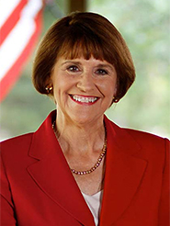
Know Your Opposition Voting Matters!
Senator Gayle Harrell (R)
Senate Health Policy Chair
District 25 Office
215 SW Federal Highway
Suite 203
Stuart, FL 34994
(772) 221-4019
Senate VOIP: 42500
FAX (888) 263-7895
Tallahassee Office
310 Senate Building
404 South Monroe Street
Tallahassee, FL 32399-1100
(850) 487-5025
Senate VOIP: 5025
Incumbent Preceded by Negron
Her Democratic opponents are Reinaldo Diaz and Corinna Robinson
Notes:
Image retrieved on 7-11-19 from http://www.flsenate.gov/Senators/S25
Gayle Harrell has been a wonderful friend of medicine during her public service in the Florida House. We are thrilled to support her in her quest to serve in the Florida Senate and look forward to working with her on important health care issues. Gayle Harrell is a tremendous advocate not just to Florida physicians, but to the patients of this state as well,” said Dr. Mike Patete, president of FMA PAC. Harrell has more than 30 years of experience in health care, including managing the practice of her husband, Dr. James E. Harrell

Slide 33
ARE REGISTERED TO VOTE?
ARE YOU A SUPER VOTER?
PLAN TO MAIL-IN BALLOT
Notes:
In all, 21 of the 40 Senate seats are up for election this year, with nine of the seats open because incumbents are term-limited or leaving office for other reasons.
The incumbent senators who were listed on the state Division of Elections website Tuesday as having qualified were Sen. Doug Broxson, R-Gulf Breeze; Sen. Travis Hutson, R-St. Augustine; Sen. Victor Torres, D-Orlando; Sen. Debbie Mayfield, R-Rockledge; Sen. Darryl Rouson, D-St. Petersburg; Sen. Joe Gruters, R-Sarasota; Sen. Gayle Harrell, R-Stuart; Sen. Lori Berman, D-Lantana; Sen. Perry Thurston, D-Fort Lauderdale; and Sen. Jose Javier Rodriguez, D-Miami.
Sen. Randolph Bracy and Sen. Linda Stewart, both Orlando Democrats, were not listed as having qualified, though both have opened campaign accounts to run again this year.

Slide 34
2020-2021 Legislative Strategy
Survey
Survey the support and opposition in the House and Senate
Secure
Secure strong supporters (“champions”) for the cause
Develop/edit
Develop/edit informational “one-pagers” for dissemination
Discuss
Discuss bill language to secure FPA for all APRNs
Evaluate
Evaluate statutory language to clarify vagueness
Work
Work with the BON, BOM, and DOH in the rulemaking process and implementation of HB 607
Educate
Educate on the issues and encourage advocacy by NPs/APRNs
Notes:
FIX APRN-IP!! ALL APRNS for Independent Practice

Slide 35
COVID-19 and the APRN ROLE
The NP: Providing urgent care, critical care, primary care, specialty care, administrative oversight, and education in person and via remotely via telemedicine. Some furloughed, some moved to high risk areas, most went Tele-Health
The CNS: Uniquely trained to optimize outcomes for COVID-19 disease management, health promotion, illness risk prevention, and best practices for complex cases. Hospital based care.
The CRNA: Caring for both the most acutely ill patients requiring intubation while in both inpatient and outpatient roles, they are one of the most at risk groups of providers nationwide. Worked ICUs when elective surgery cancelled.
The CNM: Providing multi-faceted care for the pre-natal, delivery, and postpartum stages in a dangerous time of uncertainty where resources have been scarce and stress unyielding. High risk group and long exposure time to Covid
Notes:
As COVID 19 continues to impact every facet of healthcare, we must share how the APRN is involved on the frontlines. APRNs across the nation are answering the call and putting themselves in harms way to provide optimal care for Americans.

Slide 36
How do we move forward?
Notes:
With 900 to 1000 new residents moving to Florida each day, and 4.5 million more residents expected to call Florida home by 2030, it’s vital that Floridians have increased access to safe, quality healthcare
Advocacy image retrieved on 7-11-19 from https://www.iaml.info/advocacy-committee

Slide 37
August is APRN Advocacy Month
WHAT IS IT? AND WHY?
The Florida Coalition of Advanced Practice Nurses has declared August as APRN Advocacy Month.
This is an effort to get all APRNs/APRN Organizations prepared to meet with as their legislators (House and Senate) during the month of August to educate them on the benefits of autonomous APRN practice.
Weekly educational topics will prepare attendees for the upcoming legislative session and increase the confidence of those making visits to legislators.
Educating lawmakers will help with their understanding of APRN issues and get them up to speed ahead of the legislative Session starting.
Notes:
This information will be sent to member orgs for dissemination and will be available on the FCAPN website at www.APRNadvocacy.com

Slide 38
What Next?
The Florida Coalition of APNs and your State Association can provide you with education and handout(s) for your appointment visits.
Please plan on attending our Part 2 Webinar on Tuesday, July 30th at 7:30pm.
This Part 2 webinar will cover the following topics:
1. How to Talk with Your Legislator about APRN Autonomous Practice,
2. Legislative Talking Points,
3. Legislative Appointment Scheduling, and
4. Execution of Strategy
We will also cover 4 themes during August APRN Advocacy Month through social media and other communication forums to help highlight APRN Autonomous Practice.

Slide 39
Themes of August APRN Advocacy Month
Week of 8/5 – Locating Laws for FL
Week of 8/12 – Legislator Letter Writing
Week of 8/19 – The Rulemaking Process
Week of 8/26 – Visiting Legislators / Tallahassee Travel
Let’s make sure we spread the word about APRNs to as many legislators as possible and help encourage legislation that would assist giving Floridians greater access to high quality, affordable care.

Slide 40
Stay in the Know
www.APRNadvocacy.com
Sign up for the newsletter and get updated on most recent information
If not a member of a Coalition member organization, JOIN ONE
Take part in email campaigns and calls to action
Notes:
Content ends here…3 more .PROMO slides follow

Slide 41
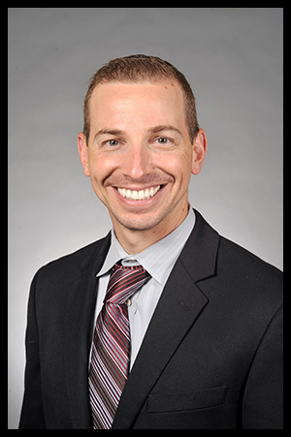
A Special Thanks for Your Leadership
Erik Rauch DNP, APRN, CRNA
Immediate Past Co-Chair of FCAPN
Past President of FANA 2018-20
Past FCAPN Co-Chairs
Bonnie Marting - FNA
Chris Saslo - FNPN
Doreen Cassarino - FNPN
Mai Kung - FNA
Gail Sadler - Assoc NP Biz
Ed Briggs - FNA
George Peraza Smith - GAPNA
Gwen Thompson - FANA
Bruce Weiner - FANA

Slide 42
Are there any Questions?
Do not forget to attend Part 2 of the Annual Advocacy Awareness Webinar on Tuesday July 30th at 7:30pm!
Look for emails from your Local and State Associations with Zoom Meeting details and call-in info!

Slide 43
References
https://www.myfloridahouse.gov/FileStores/Web/House Content/Approved/ClerksOffice/GuideToFlorida.pdf
https://www.flsenate.gov/PublishedContent/ADMINISTRATIVE PUBLICATIONS/SeatingChart.pdf
https://www.flsenate.gov/Committees/BillSummaries/2020/
https://www.flsenate.gov/About/HowAnIdeaBecomesALaw
http://archive.flsenate.gov/SenateKids/bill-becomes-law.cfm
https://www.flgov.com/legislation/
https://www.floridanurse.org/page/Advocacy
https://fnpn.enpnetwork.com/page/36625-2020-legislative-session
https://www.flanp.org/page/TheAPRNSolution
http://florida.midwife.org
https://www.fana.org
https://flnapnap.enpnetwork.com
https://anpbfl.enpnetwork.com
https://flcns.org
Notes:
Required for CE

