Slide 1
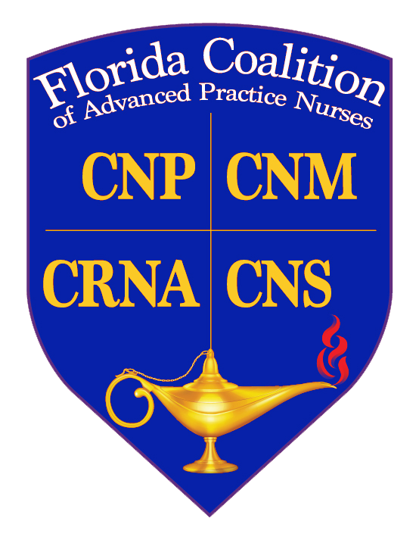
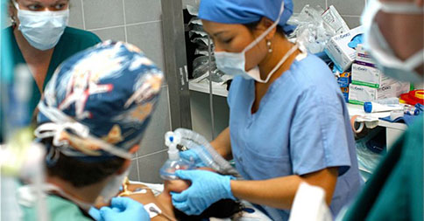
APRN Roles: Four Roles, Four Ways to Care
1
2
Dr. Stacia M. Hays, DNP, APRN, CPNP-PC, CNE, FAANP Dr. Paula Timoney, DNP, APRN, NNP-BC Dr. Arlene Wright, DNP, APRN, FNP-BC, FNAP
3
4
Notes:
Advanced Practice Registered Nurses (APRN) independently evaluate and manage patients under established protocol with a licensed physician. Four advanced practice roles are recognized in Florida’s Nurse Practice Act.

Slide 2
APRN Education
Master of Science in Nursing (MSN)
Doctor of Nursing Practice (DNP): expert clinicians, translate evidence into practice, quality improvement initiatives
Doctor of Philosophy (PhD): research-focused, generating new knowledge
Notes:
Doctorate (DNP or PhD) or Masters Prepared (2 to 6 years beyond a bachelor’s degree).
Advanced practice nurses must complete an accredited graduate nursing program AND pass an appropriate national specialty certification exam AND document ongoing continuing education.
Doctoral Degrees in Nursing include PhD and DNP
PhD - Doctor of Philosophy in nursing. PhD is a research focused degree, with the purpose of generating new knowledge. PhD-prepared nurses conduct research, may be employed in the academic and/or clinical settings, and may participate in organizational leadership roles.
DNP- Doctor of Nursing Practice. DNP degree is a terminal clinical practice degree that creates nursing leaders in clinical roles, interdisciplinary health care teams, organizational leadership roles, translating evidence gained through nursing research into practice, improving systems of care and measuring outcomes of patient groups, populations and communities.. DNP-prepared nurses are expert clinicians and may be employed in the academic setting.
Doctoral – 4-6 years beyond Baccalaureate.

Slide 3
APRNs by the Numbers
NPs in US: >290,000 more than 1 billion patient visits ¹
CRNAS: 49,000 treated 40,000 patients² and 43 million anesthetics each year³
CNS: 72,000 certified in Adult/Gerontology, Pediatrics, Neonatal
CNM: 1,218 attended 351,968 births⁵
1 AANP retrieved from https://storage.aanp.org/www/documents/research/2020-NP-Infographic-Final.pdf
2 Florida Association of Nurse Anesthetists (FANA) retrieved from https://fana.memberclicks.net/assets/CRNAs%20At%20A%20Glance.pdf
3 FANA retrieved from https://www.fana.org/index.php?option=com_content&view=article&id=67:what-is-a-nurse-anesthetist-&catid=20:site-content&Itemid=153
4 NACNS Retrieved from https://explorehealthcareers.org/career/nursing/clinical-nurse-specialist/#:~:text=There%20are%20approximately%2072%2C000%20clinical,nursing%20homes%2C%20corporations%20and%20prisons; https://nacns.org/professional-resources/practice-and-cns-role/cns-census/
5 ACNM retrieved from https://www.midwife.org/acnm/files/cclibraryfiles/filename/000000007531/EssentialFactsAboutMidwives-UPDATED.pdf
Notes:
CNS in 3 areas of certification

Slide 4
APRN Roles
Certified Registered Nurse Anesthetist
Certified Nurse Midwife
Certified Nurse Practitioner
Clinical Nurse Specialist
Notes:
Profession vs role
APRN’s are Registered Nurses with advanced degrees Advanced Practice nurses who practice at an advanced level, providing care in a specific role and/or patient population. They are educated to independently provide a wide range of healthcare services in a variety of healthcare settings. The APRN role consists of 4 areas:
-Certified Nurse Practitioner (NP) is educated and certified in a population focused area and provides initial, ongoing and comprehensive care for acute and chronic illnesses, health histories and provide complete physical examinations: diagnose and treat many common acute and chronic problems; order and interpret laboratory results and X-rays; prescribe and manage medications and therapies, provide health teaching and supportive counseling with an emphasis on prevention of illness and health maintenance; and provider referrals to specialty providers as appropriate.
-Certified Nurse Midwife (CNM) provides comprehensive well- women care and manages the patient during labor and delivery, including ordering and performing some anesthetic procedures.
-Certified Registered Nurse Anesthetist (CRNA) selects and administers regional and general anesthetic agent, supports life function, and oversees patient recovery.
-Clinical Nurse Specialist (CNS) assesses and manages health status of individuals and families, often as educators, care coordinators for complexly ill patients, or expert consultants for nursing staff.

Slide 5
Certified Registered Nurse Anesthetist (CRNA)
Provides comprehensive anesthesia care to patients before, during and after surgical and obstetrical procedures
Practices in every setting in which anesthesia is administered
traditional hospital and obstetrical surgical suites
interventional pain managements
critical care units
ambulatory surgical centers
https://www.floydleelocums.com/2018/01/26/crna-week-2018/
Notes:
Primary anesthesia professionals in rural and medically underserved areas.
CRNA medicare part D providers
American College of Nurse Midwives

Slide 6
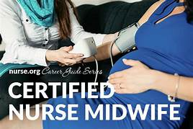
Certified Nurse Midwife (CNM)
“Midwifery” means the practice of supervising the conduct of a normal labor and childbirth, with the informed consent of the parent; the practice of advising the parents as to the progress of childbirth; and the practice of rendering prenatal and postpartal care. (467.003(8), Florida Statutes)
Notes:
CNMs are licensed, independent health care providers with prescriptive authority in all 50 states, the District of Columbia, American Samoa, Guam, Puerto Rico and USVI. CNMs are defined as primary care providers under federal law.
-2017: attended 351,968 births (9.1% total of US births)
94.1% of births in hospital, 3.2% freestanding birth centers, 2.6% in homes
Medicaid reimbursement mandatory

Slide 7
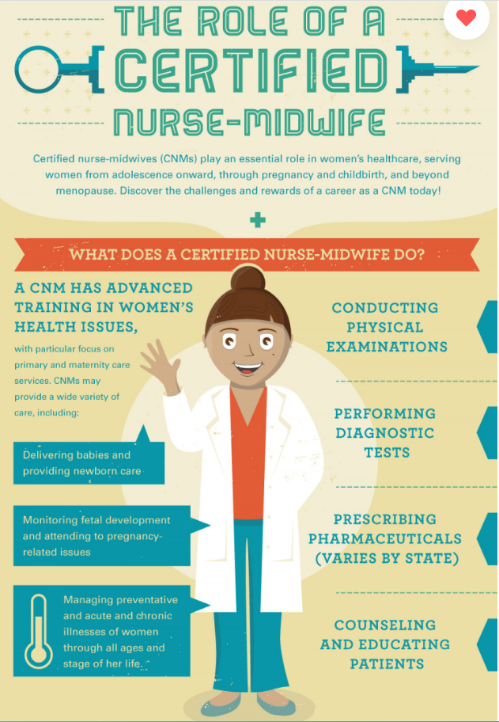

Slide 8
Certified Nurse Practitioner Advanced Practice Registered Nurse with advanced and graduate education and training to Assess, diagnose, treat, prescribe, and provide comprehensive healthcare
Certified Nurse Practitioner (CNP)
Retrieved from https://comprehensiveprimarycare.com/providers/nurse-practitioners/
Notes:
Assess, diagnose, treat, prescribe, comprehensive perspective to healthcare
Educated and trained o manage the health and wellness of populations across the healthcare continuum
APRN’s are Registered Nurses with advanced degrees Advanced Practice nurses who practice at an advanced level, providing care in a specific role and/or patient population. They are educated to independently provide a wide range of healthcare services in a variety of healthcare settings. The APRN role consists of 4 areas:
-Certified Nurse Practitioner (NP) is educated and certified in a population focused area and provides initial, ongoing and comprehensive care for acute and chronic illnesses, health histories and provide complete physical examinations: diagnose and treat many common acute and chronic problems; order and interpret laboratory results and X-rays; prescribe and manage medications and therapies, provide health teaching and supportive counseling with an emphasis on prevention of illness and health maintenance; and provider referrals to specialty providers as appropriate.

Slide 9
APRN Certifications
Adult/Gerontology
Family Practice
Neonatal
Pediatric
Psychiatric Mental Health
Women’s Health
Notes:
Population focused

Slide 10
Expert clinicians with advanced education and training in a specialized area of nursing practice who work in a wide variety of health care settings
Clinical Nurse Specialist (CNS)
Notes:
The APRN Consensus Model states that clinical nurse specialists who practice in the majority of states must obtain certification based on a population area. Current certification examinations based on population include:
Adult/Gerontology
Pediatrics
Neonatal

Slide 11
Clinical Nurse Specialist (CNS)
Defined by:
Population (pediatrics, geriatrics, women’s health)
Setting (critical care, emergency room)
Disease or medical subspecialty (diabetes, oncology)
Focus of care (psychiatric, rehabilitation)
Focus on specific areas (pain, wounds, stress).
Notes:
The clinical nurse specialist has been a part of the health care industrial complex in the United States for more than 60 years. Through the decades, the profession has become widely accepted in the health care system as a standardized, licensed, and fully regulated health care occupation, and one that significantly impacts the nation’s economy by providing safe, low-cost, and effective evidence-based health care services.
Clinical nurse specialists are expert clinicians with advanced education and training in a specialized area of nursing practice who work in a wide variety of health care settings. In addition to conventional nursing responsibilities, which focus upon helping patients to prevent or resolve illness, a clinical nurse specialist’s scope of practice includes diagnosing and treating diseases, injuries and/or disabilities within his/her field of expertise.A clinical nurse specialists’ specialty may be defined by:
population (such as: pediatrics, geriatrics, women’s health);
setting (such as: critical care or emergency room);
disease or medical subspecialty (such as: diabetes or oncology);
type of care (such as: psychiatric or rehabilitation); or
type of problem (such as: pain, wounds, stress).

Slide 12
Population-Focused Care
Family/Across the Lifespan
Adult/Gerontology—Acute and Primary Care
Women’s Health/Gender-Related
Pediatric—Acute and Primary Care
Neonatal
Psychiatric/Mental Health

Slide 13
Consensus Model for APRN Regulation: Licensure, Accreditation, Certification & Education (2008)
https://www.ncsbn.org/Consensus_Model_for_APRN_Regulation_July_2008.pdf

Slide 14
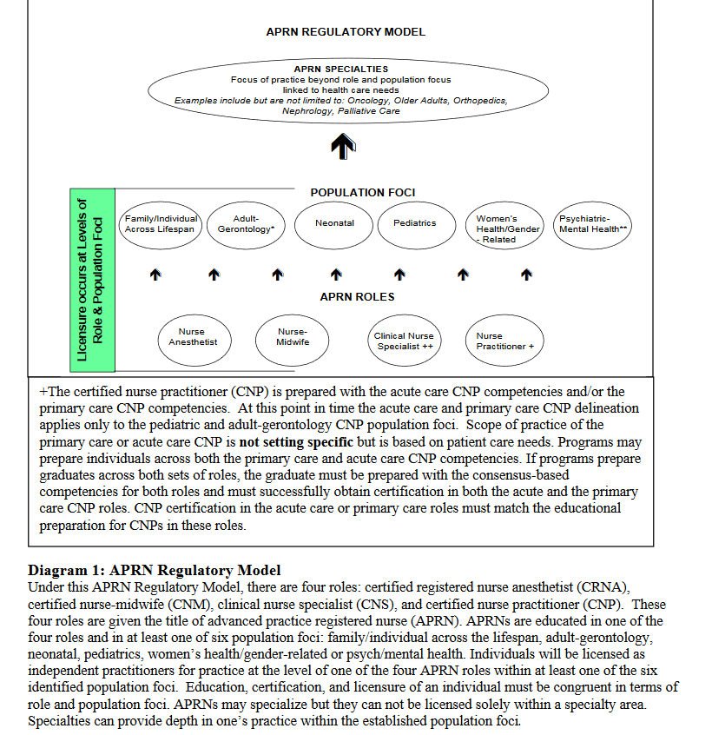

Slide 15
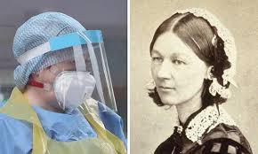
Retrieved from https://rcni.com/nursing-standard/opinion/comment/international-nurses-day-what-would-florence-do-covid-19-front-line-160886

Slide 16
Photo Credits
Title slide
1- https://online.missouri.edu/degreeprograms/nursing/dnp/pediatric-clinical-nurse-specialist/
2- https://nyulangone.org/locations/rusk-rehabilitation
3-https://mbmps.com/time-say-thank-crnas/
4- https://www.istockphoto.com/photo/pregnant-african-american-mid-adult-patient-being-examined-with-a-stethoscope-gm1065528444-284939757?utm_source=pixabay&utm_medium=affiliate&utm_campaign=SRP_image_sponsored&referrer_url=https%3A%2F%2Fpixabay.com%2Fimages%2Fsearch%2Fmidwife%2F&utm_term=midwife

