Slide 1
August Advocacy Month Preparation Webinar Part I
Presented by: Erik Rauch DNP, CRNA, NSPM-C
Vernon M. Langford MSN, APRN, FNP-C

Slide 2
Brief Legislative Process Review How does an idea become a law in Florida?
A legislator or an interested party has an idea that is brought to the attention of the proper person, generally a legislator. That idea is then drafted into a bill or proposed legislation. A bill can originate in either chamber (House of Representatives or Senate), however the process differs slightly between chambers.
Either a member of the House or Senate can file a bill. The bill is assigned to a committee or several committees, depending on the content of the measure. These proposals usually have a companion bill in the other chamber. Companion bills are similar and address the same issues.
The proposed legislation is amended and debated at the committee level. If approved in committee, they are forwarded to the next committee of reference and then to the floor of the House of Representatives and Senate for further action. Further debate and amendments can occur on the floor of either the Senate or the House. Companion bills often move through the process concurrently.
If a bill passes in one house, it is sent to the other house for review. A bill goes through the same process in the second house as it did in the first. A bill can go back and forth between chambers until a consensus by lawmakers is reached. Of course, the measure could fail at any point in the process.
Once a bill has passed on the floor in both chambers in identical form, it proceeds to the Governor for a signature. Once signed by the Governor, the bill becomes law. If the Governor vetoes the bill, then it takes a 2/3 majority of both the Senate and the House to override his veto. A bill may also become a law if the Governor does not sign or veto it within a specific amount of time after the bill has been presented to the Governor.
The public, lobbyists, or a group's representatives can provide input on the legislation at each of the above stages.

Slide 3
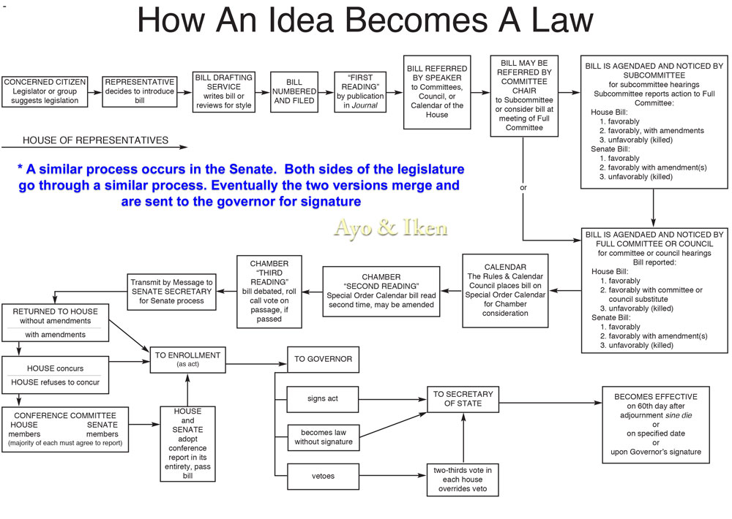
How An Idea Becomes Law –FL HOUSE

Slide 4
How An Idea Becomes Law –FL SENATE

Slide 5
House Bill 821 (2019)
Filed by Representative Cary Pigman.
Would have granted “independent practice” to APRNs who meet the following requirements and who registered with the Board of Nursing:
The APRN must have an active, unencumbered license to practice as an APRN in Florida and not have been subject to disciplinary action in Florida or any other state within the past 5 years
The APRN must have completed at least 2,000 clinical practice hours or clinical instruction hours while practicing as an APRN under the supervision of a MD or DO with an unencumbered license, or the APRN must have completed a graduate-level course in pharmacology.

Slide 6
House Bill 821 (2019) Continued
The Board of Nursing would register APRNs who meet the stated qualifications for independent practice and that APRN would have received an independent practice license (by role).
Independent APRNs would have had to renew their licenses every 2 years and take 10 hours of continuing education in addition to the 30 hours required for licensee renewal.
The bill required independent APRNs to report adverse incidents involving controlled substances.

Slide 7
House Bill 821 (2019) Continued
Stated that the Board of Nursing “may” establish an advisory committee made up of 3 APRNs, 3 physicians appointed by the Board of Medicine, and Surgeon General or designee, “to make evidence-based recommendations about medical acts that an independent practice APRN may perform.”
The Board of Nursing “must act on” the Committee’s recommendations within 90 days following submission.

Slide 8
House Bill 821 (2019) Continued
The bill would have added several grounds for disciplinary action against independent practice APRNs, which are taken nearly verbatim from Chapters 458 and 459 (statutes regulating MD and DO practice), for acts including:
Paying or receiving a commission, bribe or kickback, or engaging in split-fee arrangements, for referring patients to a provider or facility.
Exercising influence within a patient relationship to engage a patient in sexual activity.
Making a deceptive, untrue or fraudulent representations related to advanced nursing practice.
Experimentation on a human subject.
Delegating professional responsibilities to a person the APRN knows or has reason to believe is not qualified to perform.

Slide 9
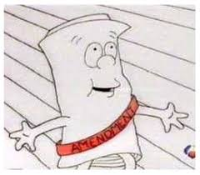
House Bill 821 (2019) SURPRISE AMENDMENT
Tuesday March 12th at the House Health Policy Subcommittee Meeting there was a new amendment added to the bill.
The amendment changes the word “independent” to “autonomous”, and added “autonomous Physician Assistants” to the bill. Therefore, as the bill currently stands it would create both “autonomous APRNs” and “autonomous PAs” in the FL Statute.

Slide 10
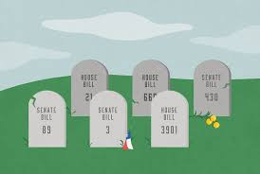
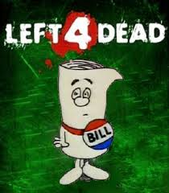
House Bill 821 (2019) PROGRESS
The bill passed the House Health Policy Subcommittee Meeting, the House Health Appropriations Committee, and the full House of Representatives.
The bill was then sent to the house where it went… NOWHERE.
Notes:
Tombstone image retrieved on 7-11-19 from https://www.google.com/search?biw=1787&bih=856&tbm=isch&sa=1&ei=SVspXbeJJsO0tAaK6JLoDw&q=house+bill&oq=house+bill&gs_l=img.3..0l10.2094.4424..4626...1.0..0.114.760.10j1......0....1..gws-wiz-img.......0i67j0i10.KCXOOPZW5xA#imgrc=65aJCcVRUtD0HM:
Bill image retrieved on 7-11-19 from https://www.google.com/search?biw=1787&bih=856&tbm=isch&sa=1&ei=SVspXbeJJsO0tAaK6JLoDw&q=DEAD+BILL&oq=DEAD+BILL&gs_l=img.3..0l2j0i5i30l5j0i8i30l3.6864.13313..13608...0.0..1.279.1168.16j0j1......0....1..gws-wiz-img.......0i67j0i10j0i24.LibnTbJYwTo#imgrc=fRzYFosOPTESNM:

Slide 11
Senate Bill 972 (2019) (WENT NOWHERE)
Filed by Senator Jeff Brandes.
Utilized language crafted by the National Council of State Boards of Nursing (NCSBN) that focused on the APRN Consensus Model.
Focused on removal of supervision protocols for APRNs to indirectly achieve independent practice (does not specifically use the terminology independent in the bill).
Did not use language that disqualified individuals who have had disciplinary action within the past 5 years like HB 821.

Slide 12
Senate Bill 972 (2019) Continued
Required 2,000 hours of clinical practice hours or clinical instruction hours under supervision (like HB 821), and allowed supervision to be under a MD, DO, or APRN. Did not have the option of completing a graduate level pharmacology course in replacement (like HB 821).
Once an APRN has met the 2,000 hour requirement it allowed them to “attest” to the Board of Nursing to get the privilege to work without a supervision protocol versus giving a new independent APRN license (like HB 821). Their profile would have been updated with the attestation at that point.

Slide 13
Senate Bill 972 (2019) Continued
This bill does not add additional CE hours to maintain the privilege to work without a supervision protocol (like HB 821).
Does not have any language about a possible “advisory committee”.
Does have similar language requiring an APRN to report adverse events involving controlled substances.
Does not have the additional language adding several grounds for disciplinary action like that of MDs and DOs.

Slide 14
What did we do to push our agenda?
Personal letters to the Governor, opposing Senators, and Senate President
Intense advertising campaigns by FANA and FLANP
Persistent bill specific lobbying by Coalition member organizations
Advocacy days visits to the capitol
Communication blitz of Senator Gayle Harrell’s office

Slide 15
2019 Legislative Autopsy – What happened?
Amendment to House Bill to include PA’s
Total Obstruction from Senator Gayle Harrell
Total Obstruction from Senator Lori Berman
No forced action from Senate President Bill Galvano
No action on the Senate Bill
Unable to change the mind of the Governor Ron DeSantis
Unable to change the minds of Reps/Senators
Individual Advocacy in the districts of all elected officials
Group Advocacy in the districts of all elected officials

Slide 16
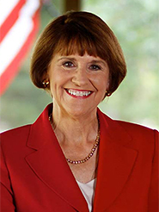
2019 Legislative Opposition
Senator Gayle Harrell (R)
Senate Health Policy Chair
District Office
215 SW Federal Highway
Suite 203
Stuart, FL 34994
(772) 221-4019
Senate VOIP: 42500
FAX (888) 263-7895
Tallahassee Office
310 Senate Building
404 South Monroe Street
Tallahassee, FL 32399-1100
(850) 487-5025
Senate VOIP: 5025
Notes:
Image retrieved on 7-11-19 from http://www.flsenate.gov/Senators/S25

Slide 17
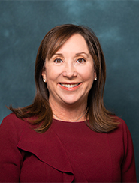
2019 Legislative Opposition
Senator Lori Berman (D)
Senate Health Policy Vice Chair
District Office
2300 High Ridge Road Suite 161 Boynton Beach, FL 33426 (561) 292-6014 Senate VOIP: 43100 FAX (888) 284-6491
Tallahassee Office
311 Senate Building 404 South Monroe Street Tallahassee, FL 32399-1100 (850) 487-5031 Senate VOIP: 5031
Notes:
Image retrieved on 7-11-19 from https://www.google.com/search?biw=1787&bih=856&tbm=isch&sa=1&ei=gWEpXc6fCfWO9PwPh_Kg2AE&q=what+happened&oq=what+happened&gs_l=img.3..0l10.236529.238272..239126...0.0..0.67.697.13......0....1..gws-wiz-img.......0i67.0GMleCILZs0#imgrc=fnGhlE-3l5gGyM:

Slide 18
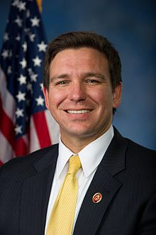
2019 Legislative Opposition
Senator Ron DeSantis (R)
Florida Governor
Tallahassee Office
Office of Governor Ron DeSantis State of Florida The Capitol 400 S. Monroe St. Tallahassee, FL 32399-0001
(850) 717-9337
Notes:
Image retrieved on 7-11-19 https://www.flgov.com/:

Slide 19
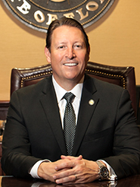
2019 Legislative Leadership
Senator Bill Galvano (R)
Senate President
District Office
1023 Manatee Avenue West Suite 201 Bradenton, FL 34205 (941) 741-3401 Senate VOIP: 42100
Tallahassee Office
305 Senate Building 404 South Monroe Street Tallahassee, FL 32399-1100 (850) 487-5021 Senate VOIP: 5021
Notes:
Image retrieved on 7-11-19 from https://www.google.com/search?biw=1787&bih=856&tbm=isch&sa=1&ei=gWEpXc6fCfWO9PwPh_Kg2AE&q=what+happened&oq=what+happened&gs_l=img.3..0l10.236529.238272..239126...0.0..0.67.697.13......0....1..gws-wiz-img.......0i67.0GMleCILZs0#imgrc=fnGhlE-3l5gGyM:

Slide 20
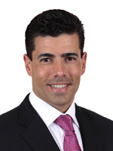
2019 Legislative Leadership
Representative Jose Oliva (R)
Speaker of the House
District Office
3798 West 12th Avenue
Suite A
Hialeah, FL 33012-4126
(305) 364-3114
Tallahassee Office
420 The Capitol
402 South Monroe Street
Tallahassee, FL 32399-1300
(850) 717-5110
Notes:
Image retrieved on 7-11-19 from https://www.google.com/search?biw=1787&bih=856&tbm=isch&sa=1&ei=gWEpXc6fCfWO9PwPh_Kg2AE&q=what+happened&oq=what+happened&gs_l=img.3..0l10.236529.238272..239126...0.0..0.67.697.13......0....1..gws-wiz-img.......0i67.0GMleCILZs0#imgrc=fnGhlE-3l5gGyM:

Slide 21
How do we move forward?
Notes:
-Advocacy image retrieved on 7-11-19 from https://www.iaml.info/advocacy-committee

Slide 22
Legislative Forecast
House Speaker Jose Oliva has made APRN Autonomous Practice a top priority for the 2020 legislative session.
Last year Speaker Oliva had two top healthcare priorities (Certificate of Need Removal, and Importing of Pharmaceuticals from Canada) get signed into law despite not getting through Senate Committees.
Senator Jeff Brandes has agreed to champion the APRN Autonomous Practice bill again.
Possible OPAGGA study to show increase workforce shortage between 2020-2030.

Slide 23
August APRN Advocacy Month
WHAT IS IT? AND WHY?
The Florida Coalition of Advanced Practice Nurses is declaring August as APRN Advocacy Month.
This is an effort to get all APRNs/APRN Organizations to meet with as many legislators (House and Senate) during the month of August to educate them on the benefits of autonomous APRN practice, and prepare them for the upcoming legislative session (Jan 2020).
The Senate actually starts Committee Meetings up again in Sept 2019 so it would be optimal to speak to as many Senators as possible before then (especially those on the Senate Healthcare Committees).

Slide 24
August APRN Advocacy Month
WHAT DO WE DO NEXT?
Contact your local House and Senate representatives to set up appointments any time during the month of August. You can also contact your State Association to let them know that you’d like to attend an appointment and they will be happy to help you with that.
It’s optimal to have more than one APRN at an appointment so after you’ve made your appointment please let your State Association know so we can track and share that appointment with other APRNs who might be interested in attending.
Make sure to take photos that we can share/highlight on social media and other communication forums to let others know about August APRN Advocacy Month and Autonomous APRN Practice legislation that’s on the horizon.

Slide 25
August APRN Advocacy Month
The Florida Coalition of APNs and your State Association can provide you with education and handout(s) for your appointment visits.
Please plan on attending our webinar on Tuesday July 30th at 7:30pm.
This webinar will cover the following topics: How to Talk with Your Legislator about APRN Autonomous Practice, Legislative Talking Points, Legislative Appointment Schedule, and Strategy Execution).
We will also cover 4 themes during August APRN Advocacy Month through social media and other communication forums to help highlight APRN Autonomous Practice.

Slide 26
Themes of August APRN Advocacy Month
Week of 8/5 – APRN Roles
Week of 8/12 – APRN Safety
Week of 8/19 – APRN Outcomes
Week of 8/26 – APRN Autonomous Practice/Economics
Let’s make sure we spread the word about APRNs to as many legislators as possible and help encourage legislation that would assist giving Floridians greater access to high quality, affordable care.

Slide 27
Questions…
????????????????????????????????????????????????????????
Don’t forget to attend August APRN Advocacy Month Webinar Part 2 on Tuesday 7/30 at 7:30pm! Look for emails from your State Association with Zoom Meeting details and call-in info!

